Slide 1

Mid-Term Project
“Golden Years”
Jessica Banoke
Angela Darel
Keith Feeney
Charlene Moore

Slide 2
GOLDEN YEARS
Help seniors connect
Teaching the uses of skype, email etc.
Opening the internet world
Bringing back the joy of life
Giving the news about bingo, old style dancing parties and many more
Organising field trips
Managing health
Explaining tests results
Booking medical transport

Slide 3
Innovation:
Golden Years was created to
help senior citizens enjoy life
provide education on technology use
help understand medical issues and test results
Application that allows to
search for nearest events
book and pay for events
search and book medical support
provides e-learning experience for seniors

Slide 4






Technologies used:
PHP
MySQL
Visual Studio
C#
Notepad++
Git Hub / Git Bash

Slide 5
Login System:
Sign Up:
Enter personal details.
Create username and password.
Option to save credit card details.
Sign In.
Accept information.
Store in Database.
Receives discounts after signing up.
Continue as Guests:
Book any events without creating an account.
Does not receive discounts.
Must input all details each time booking.
Personal Information does not save to database except booking confirmation to secure booking.

Slide 6
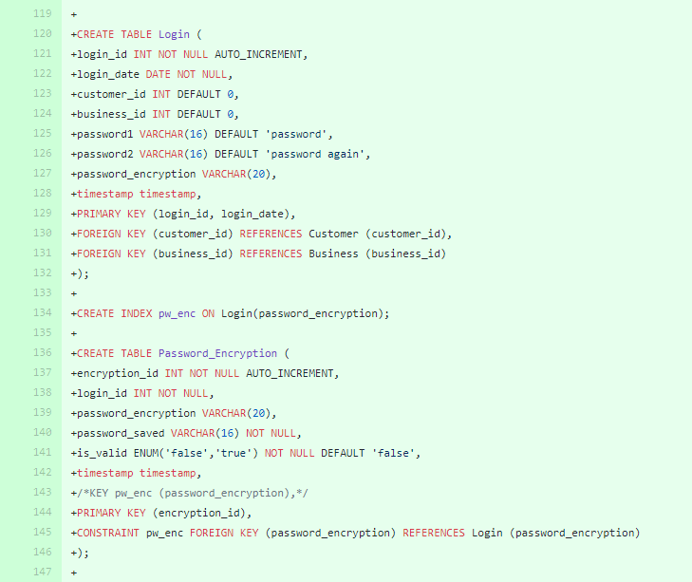
How I plan to connect the login to the database:
<?php
(“our.hostaddress.co m”,”username”,”pass word”) or die(mysql.error()); mysql_select_db(“Gol den_Years)or die (mysql_error());
//Connects to GoldenYearsBooking Database to store user’s information.
Login_id
//This is the information that will be stored if you are a user.
business_id
Login_date
Customer_id
Password_encryption

Slide 7
Payment System:
Adding event to cart
Security / Encryption
Card details.
Cookies
Acceptance/ Verification of payment ( credit cards only)
After booking it automatically adds to our booking Calendar.
Automatic confirmation email sent to confirm payment and booking.

Slide 8
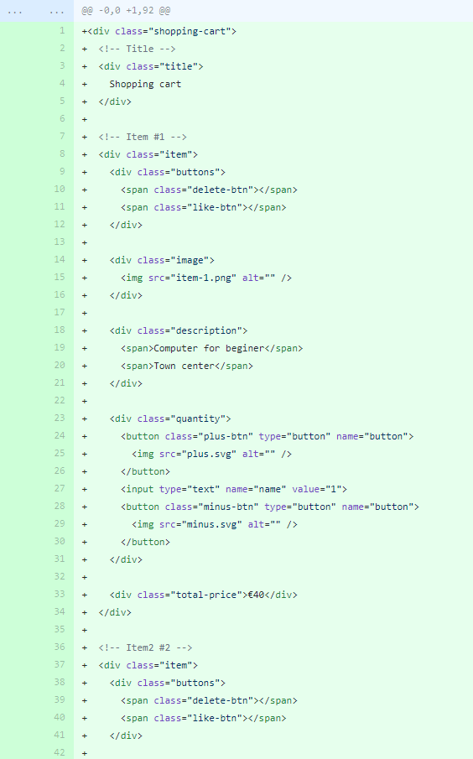
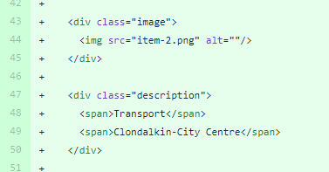
Code to add items to cart:
Item 1 and 2:

Slide 9
Current Issues:
Connecting the Database to Web Application.
Learning PHP.
Overall aesthetics.
Group dynamics.
Visual Studios is new to three members of the group so we are still trying to get to grasps with it.
Security issues.

Slide 10
Progression:
Connect the database to application
Look and feel of the Web Application
Ensure our application is secure and accessible.
Future Goals:
Secure, Accessible and convenient Application.
To expand worldwide, not just Ireland based.
Allow customers to book through booking systems set up around the country. E.g. Like the Luas tickets system.

Slide 11
References
<Use Harvard References>
Link to a website I read an article on Encrytion and hashing for Security of a password: https://benlog.com/2008/06/19/dont-hash-secrets/ (Charlene)- I will convert to Harvard in morning.

Slide 12
Thank you

